Slide 1

TRANSACTIONS AND IMPLEMENTATION TECHNIQUES
By
K.Kaviya\COE

Slide 2
ACID Properties in DBMS
A Transaction is a single logical unit of work that accesses and possibly modifies the contents of a database.
In order to maintain consistency in a database, before and after the transaction, certain properties are followed. These are called ACID properties.
the ACID property of DBMS plays a vital role in maintaining the consistency and availability of data in the database.

Slide 3
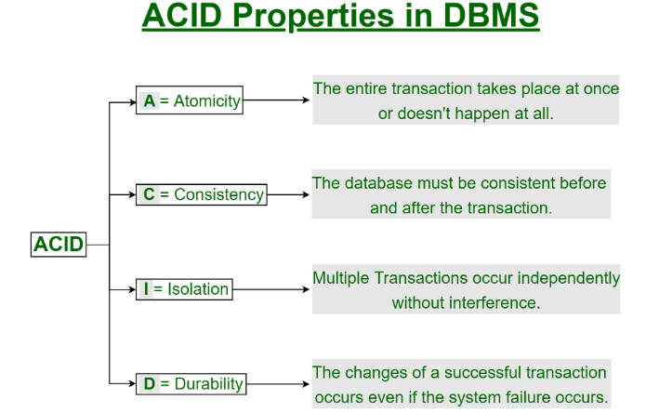

Slide 4
Atomicity:
By this, we mean that either the entire transaction takes place at once or doesn’t happen at all.
There is no midway i.e. transactions do not occur partially.
Each transaction is considered as one unit and either runs to completion or is not executed at all.
It involves the following two operations.
—Abort: If a transaction aborts, changes made to the database are not visible.
—Commit: If a transaction commits, changes made are visible.
Atomicity is also known as the ‘All or nothing rule’.

Slide 5
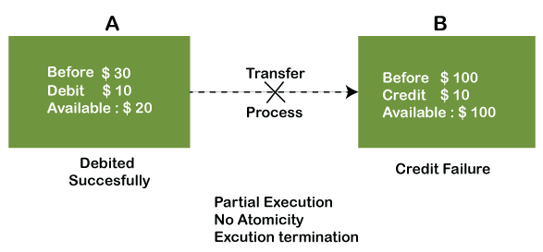
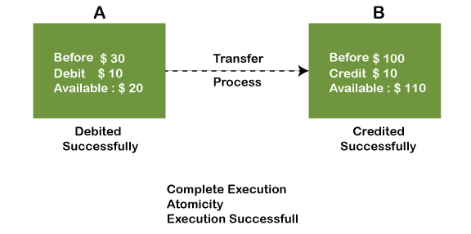
Example:
If Remo has account A having $30 in his account from which he wishes to send $10 to Sheero's account, which is B.

Slide 6
Consistency
The word consistency means that the value should remain preserved always
In DBMS, the integrity of the data should be maintained, which means if a change in the database is made, it should remain preserved always.
In the case of transactions, the integrity of the data is very essential so that the database remains consistent before and after the transaction.
The data should always be correct.

Slide 7
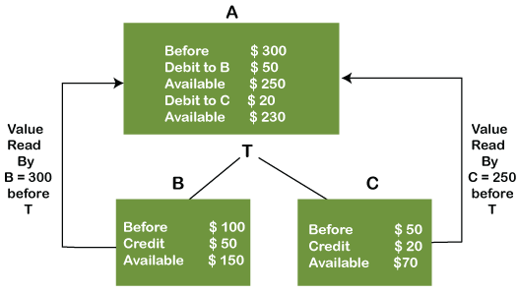
Example:
There are three accounts, A, B, and C, where A is making a transaction T one by one to both B & C.

Slide 8
Isolation
The term 'isolation' means separation.
In DBMS, Isolation is the property of a database where no data should affect the other one and may occur concurrently.
Isolation is a guarantee that concurrently running transactions should not interfere with each other.
Concurrency here refers to two or more transactions trying to modify or read the same database record(s) at the same time.

Slide 9
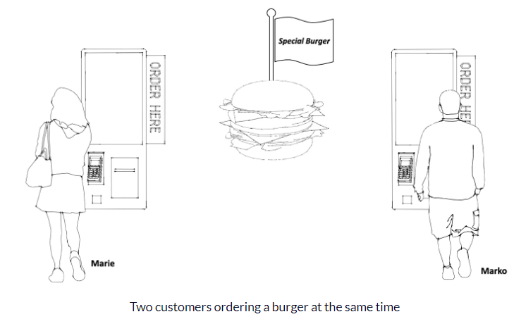
Example:
Marie places an order based on this incomplete information, thinking a burger is available.
Once Marko pays, the system updates to show that there are no burgers left. This is similar to a transaction being committed
Marie’s order will have to be aborted since there are no burgers left.

Slide 10
Example:
Marie checks the availability of burgers and sees the last one available.
Unknown to her, Marko’s order is being processed but hasn't been finalised in the system, as he has not paid.
Since his order has not yet been finalised, Marie is not aware that his order conflicts with her own.

Slide 11
What if Marko’s payment failed at this stage
?

Slide 12
Durability:
Durability ensures the permanency of something.
In DBMS, the term durability ensures that the data after the successful execution of the operation becomes permanent in the database.
The durability of the data should be so perfect that even if the system fails or leads to a crash, the database still survives.
However, if gets lost, it becomes the responsibility of the recovery manager for ensuring the durability of the database.
For committing the values, the COMMIT command must be used every time we make changes.

Slide 13
Schedules :
Schedule, as the name suggests, is a process of lining the transactions and executing them one by one.
When there are multiple transactions that are running in a concurrent manner and the order of operation is needed to be set so that the operations do not overlap each other
To calculate number of schedules
(N1 + N2 + N3 + ..... + Nn)! / (N1! * N2! * N3! * ... * Nn!)
The order in which the operations of multiple transactions appear for execution is called as a schedule

Slide 14
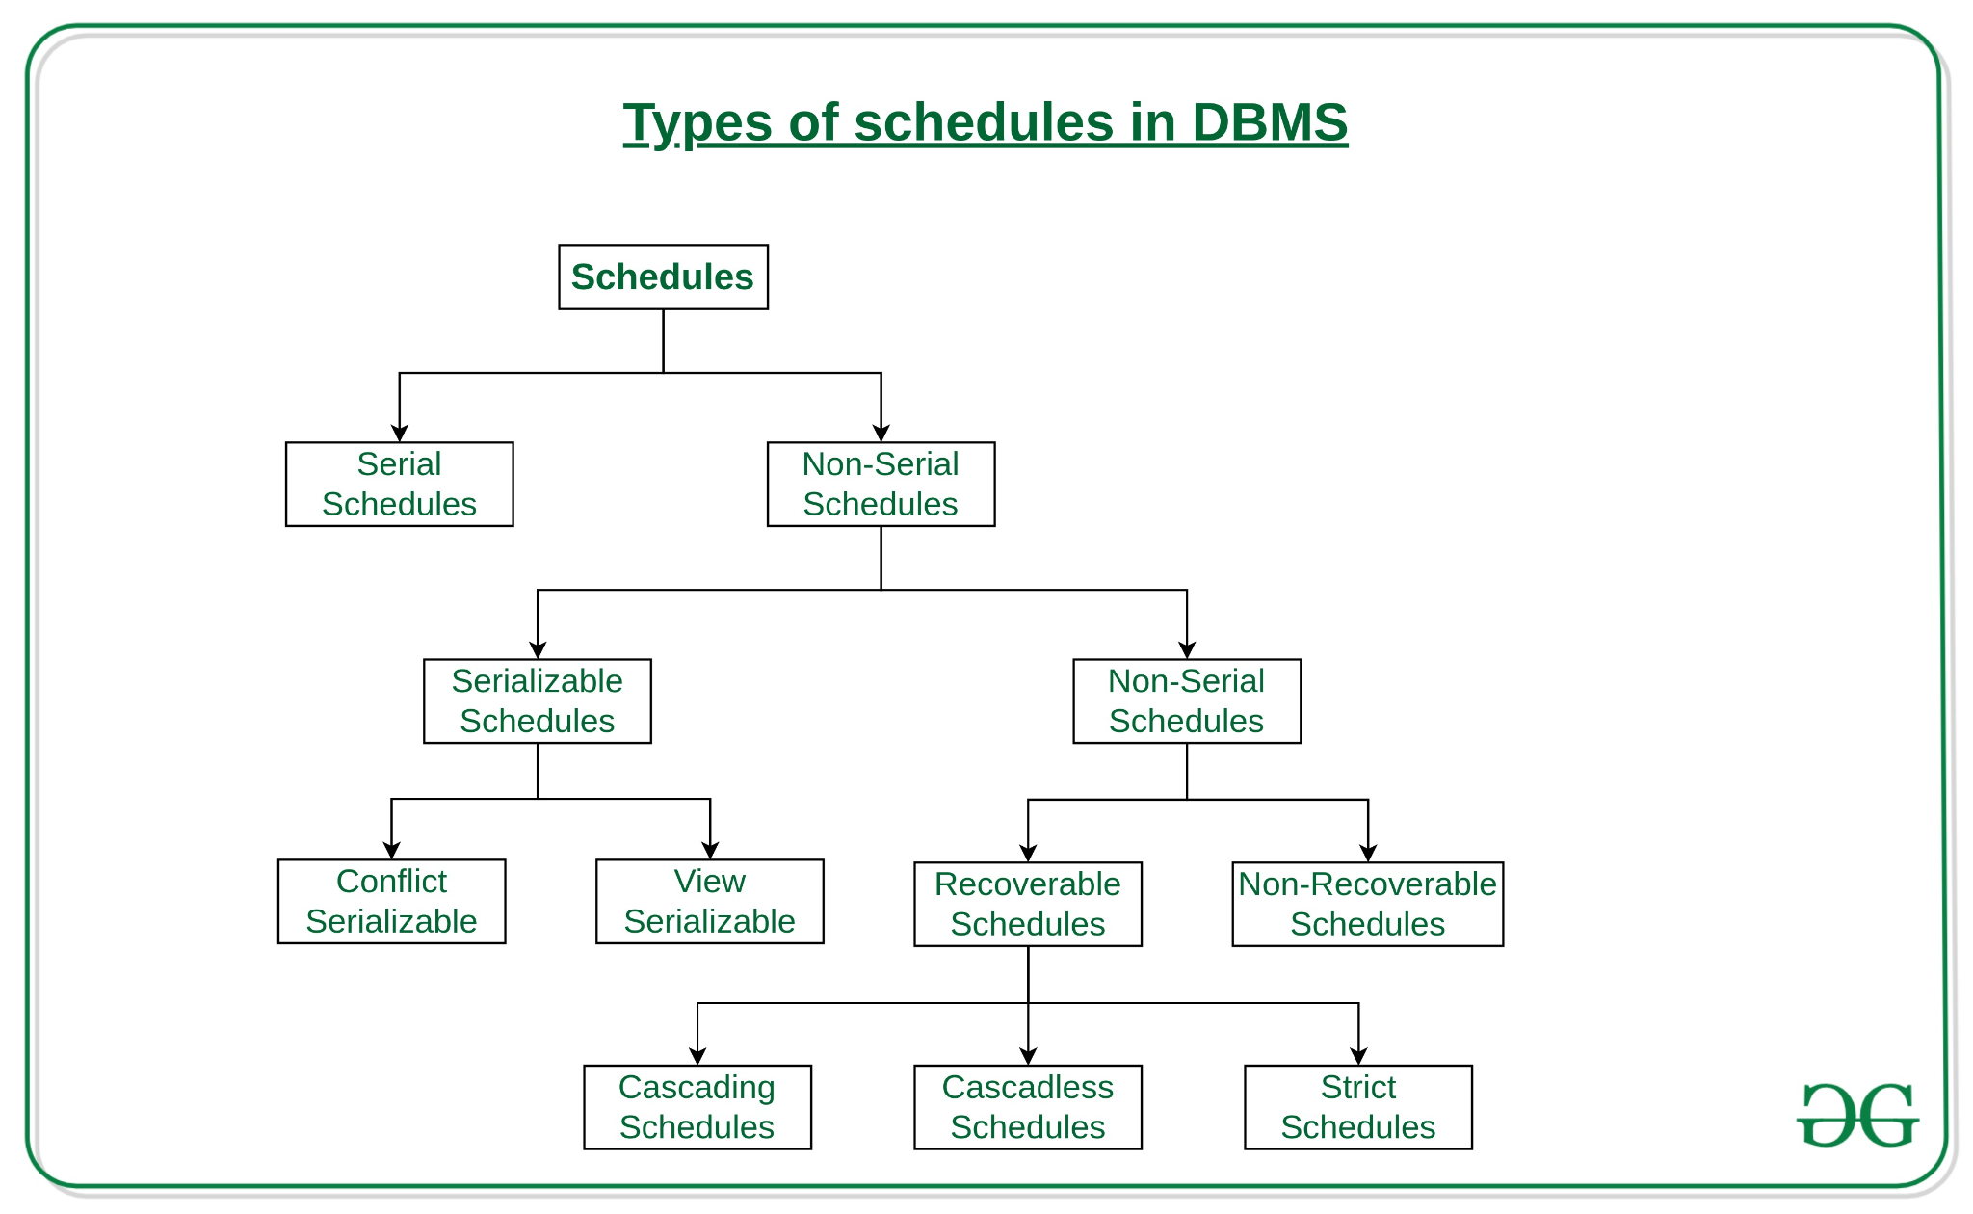
Types of Schedules
DBMS

Slide 15
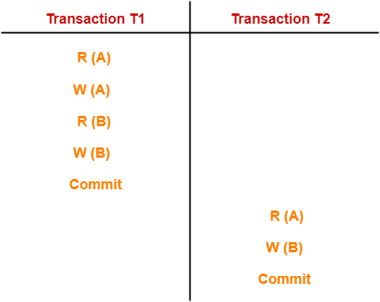
Serial Schedules:
Schedules in which the transactions are executed non-interleaved
A serial schedule is one in which no transaction starts until a running transaction has ended are called serial schedules.
So, for two above transactions the no. of serial schedule is 2
If N =number of transaction then,Number of schedule for serial schedules is N!

Slide 16
Characteristics:
Serial schedules are always
Consistent
Recoverable
Cascadeless
Strict

Slide 17
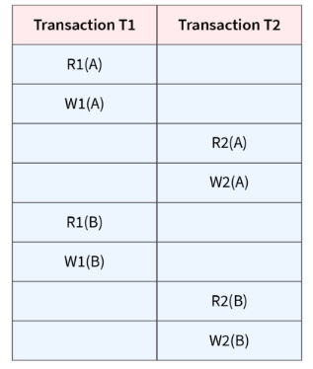
Non-Serial Schedule:
This is a type of Scheduling where the operations of multiple transactions are interleaved.
The transactions are executed in a non-serial manner, keeping the end result correct and same as the serial schedule.
Total number of non-serial schedules = Total number of schedules – Total number of serial schedules

Slide 18
Non-Serial Schedule:
This sort of schedule does not provide any benefit of the concurrent transaction. It can be of two types namely,
> Serializable Schedule
> Non-Serializable Schedule.

Slide 19
Serializable:
This is used to maintain the consistency of the database. It is mainly used in the Non-Serial scheduling to verify whether the scheduling will lead to any inconsistency or not.
The non-serial schedule is said to be in a serializable schedule only when it is equivalent to the serial schedules, for an n number of transactions.
A serializable schedule helps in improving both resource utilization and CPU throughput.
A serial schedule does not need the serializability because it follows a transaction only when the previous transaction is complete.

Slide 20
Conflict Serializability
Conflict serializability is a type of concurrency control that guarantees that the outcome of concurrent transactions is the same as if the transactions were executed consecutively.
Concurrency serializability, also known as conflict serializability,
Conflict serializable schedules: A schedule is called conflict serializable if it can be transformed into a serial schedule by swapping non-conflicting operations.
Non-conflicting operations: When two operations operate on separate data items or the same data item but at least one of them is a read operation, they are said to be non-conflicting.

Slide 21
View Serializability:
A Schedule is called view serializable if it is view equal to a serial schedule (no overlapping transactions).
Conflict schedule is a view serializable but if the serializability contains blind writes, then the view serializable does not conflict serializable.

Slide 22
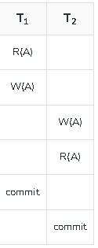
Non-Serializable:
The non-serializable schedule is divided into two types,
Recoverable and Non-recoverable Schedule.
Recoverable Schedule:
Schedules in which transactions commit only after all
transactions whose changes they read commit are called
recoverable schedules
For Example:Tj is reading value updated or written by
some other transaction Ti, then the commit of Tj must occur
after the commit of Ti.

Slide 23
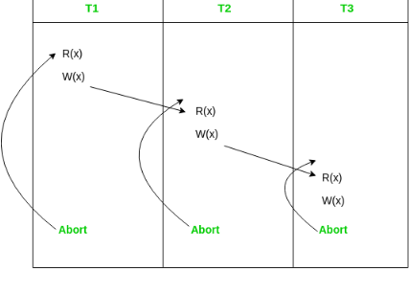
Non-Serializable:
There can be three types of recoverable schedule:
Cascading Schedule:
Also called Avoids cascading aborts/rollbacks (ACA).When there is a failure in one transaction and this leads to the rolling back or
aborting other dependent transactions, then such
scheduling is referred to as Cascading rollback
or cascading abort

Slide 24
Non-Serializable:
Cascadeless Schedule:
Schedules in which transactions read values only after all transactions whose changes they are going to read commit are called cascadeless schedules.
Avoids that a single transaction abort leads to a series of transaction rollbacks.
A strategy to prevent cascading aborts is to disallow a transaction from reading uncommitted changes from another transaction in the same schedule.C
For Example: if some transaction Tj wants to read value updated or written by some other transaction Ti, then the commit of Tj must read it after the commit of Ti.

Slide 25
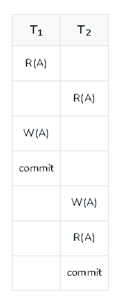
Non-Serializable:
Strict Schedule:
A schedule is strict if for any two transactions Ti, Tj,
if a write operation of Ti precedes a
conflicting operation of Tj (either read or write),
then the commit or
abort event of Ti also precedes that
conflicting operation of Tj.

Slide 26
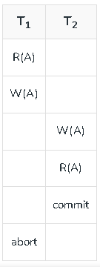
Non-Recoverable Schedule
Consider the following schedule involving two transactions T1 and T2.
T2 read the value of A written by T1, and committed. T1 later aborted, therefore the value read by T2 is wrong, but since T2 committed, this schedule is non-recoverable.

Slide 27
Points to remember:
Cascadeless schedules are stricter than recoverable schedules or are a subset of recoverable schedules.
Strict schedules are stricter than cascadeless schedules or are a subset of cascadeless schedules.
Serial schedules satisfy constraints of all recoverable, cascadeless and strict schedules and hence is a subset of strict schedules.

Slide 28
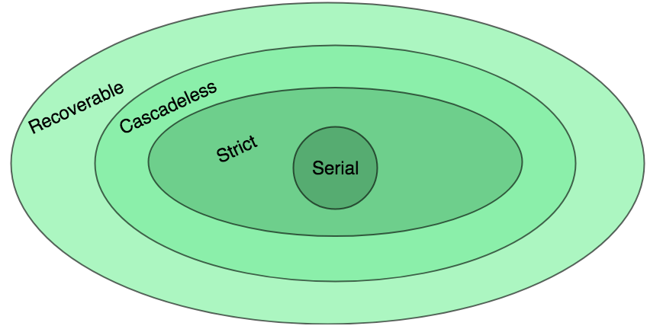
The relation between various types of schedules
Schedule in DBMS organize the order of transactions.
Proper scheduling ensures transactions work smoothly together.
Serializable schedules follow rules for consistency.
Non-serializable schedules let transactions occur at the same time, but this might cause problems and things may not make sense.

Slide 29
Guess?
Consider the following schedule:
Which of the following is true?
(A) The schedule is view serializable schedule and strict recoverable schedule
(B) The schedule is non-serializable schedule and strict recoverable schedule
(C) The schedule is non-serializable schedule and is not strict recoverable schedule.
(D) The Schedule is serializable schedule and is not strict recoverable schedule
S:R1(A), W2(A), Commit2, W1(A), W3(A), Commit3, Commit1

Slide 30
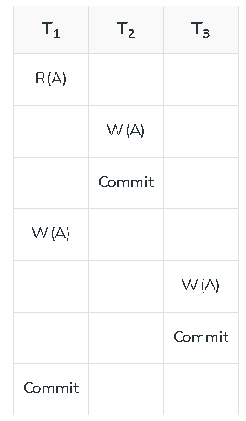
Solution:
The Schedule is serializable schedule and is not strict recoverable schedule
Reason:
it is a view serializable schedule as it has view equal serial schedule
T1 —> T2 —> T3 which satisfies the initial
and updated reads and final write on variable A
which is required for view serializability.
And also there is write – write pair done by
transactions T1 followed by T3 which is violating the
above-mentioned condition of strict schedules as T3 is supposed
to do write operation only after T1 commits
which is violated in the given schedule.

Slide 31
Concurrency Control
Executing a single transaction at a time will increase the waiting time of the other transactions
which may result in delay in the overall execution. Hence for increasing the overall throughput and efficiency of the system, several transactions are executed.
Concurrency control is a very important concept of DBMS which ensures the simultaneous execution or manipulation of data by several processes or user without resulting in data inconsistency.
Concurrency control provides a procedure that is able to control concurrent execution of the operations in the database. .

Slide 32
Need for concurrency control
It improves performance on the database
It enhances Scalability
It increases User Experience
It improves real-time data processing
It helps maintain consistent data

Slide 33
Concurrency Control Problems
There are several problems that arise when numerous transactions are executed simultaneously in a random manner.
The database transaction consist of two major operations “Read” and “Write”.
It is very important to manage these operations in the concurrent execution of the transactions in order to maintain the consistency of the data.

Slide 34
Dirty Read Problem(Write-Read conflict)
Dirty read problem occurs when one transaction updates an item but due to some unconditional events that transaction fails but before the transaction performs rollback, some other transaction reads the updated value. Thus creates an inconsistency in the database.
Dirty read problem comes under the scenario of Write-Read conflict between the transactions in the database

Slide 35
Example:
For example:The lost update problem can be illustrated with the below scenario between two transactions T1 and T2.
Transaction T1 modifies a database record without committing the changes.
T2 reads the uncommitted data changed by T1
T1 performs rollback
T2 has already read the uncommitted data of T1 which is no longer valid, thus creating inconsistency in the database.

Slide 36
Lost Update Problem
Lost update problem occurs when two or more transactions modify the same data, resulting in the update being overwritten or lost by another transaction.
T1 reads the value of an item from the database.
T2 starts and reads the same database item.
T1 updates the value of that data and performs a commit.
T2 updates the same data item based on its initial read and performs commit.
This results in the modification of T1 gets lost by the T2’s write which causes a lost update problem in the database.

Slide 37
Concurrency Control Protocols
Concurrency control protocols are the set of rules which are maintained in order to solve the concurrency control problems in the database.
It ensures that the concurrent transactions can execute properly while maintaining the database consistency.
The concurrent execution of a transaction is provided with atomicity, consistency, isolation, durability, and serializability via the concurrency control protocols.
There are two types :
Locked based concurrency control protocol
Timestamp based concurrency control protocol

Slide 38
Locked based Protocol
lock-based concurrency control (BCC) is used to control the access of multiple transactions to the same data item.
This protocol helps to maintain data consistency and integrity across multiple users.
In the protocol, transactions gain locks on data items to control their access and prevent conflicts between concurrent transactions.

Slide 39
Shared Lock (S) and Exclusive Lock (X)
Shared Lock (S):
It is also known as Read-only lock
As the name suggests it can be shared between transactions because while holding this lock the transaction does not have the permission to update data on the data item.
S-lock is requested using lock-S instruction.
Exclusive Lock (X):
Data item can be both read as well as written.
This is Exclusive and cannot be held simultaneously on the same data item
X-lock is requested using lock-X instruction.

Slide 40
Two kind of lock based protocol
1.Two Phase Locking Protocol:
Two phase locking protocol is a widely used technique which ensures strict ordering of lock acquisition and release. Two phase locking protocol works in two phases.
* Growing Phase
The transaction starts acquiring locks before performing any modification on the data items
Once a transaction acquires a lock,that lock can not be released until the transaction reaches the end of the execution.
*Shrinking Phase
The transaction releases all the acquired locks once it performs all the modifications on the data item.
Once the transaction starts releasing the locks, it can not acquire any locks further.

Slide 41
Two kind of lock based protocol
2.Strict Two Phase Locking Protocol:
It is almost similar to the two phase locking protocol
Because,strict two phase locking the transactions are only allowed to release the locks only when they performs commits.

Slide 42
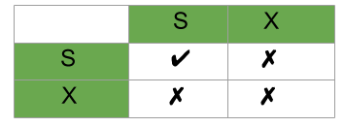
Lock Compatibility Matrix:
A transaction may be granted a lock on an item if the requested lock is compatible with locks already held on the item by other transactions.
Any number of transactions can hold shared locks on an item, but if any transaction holds an exclusive(X) on the item no other transaction may hold any lock on the item.
If a lock cannot be granted, the requesting transaction is made to wait till all incompatible locks held by other transactions have been released. Then the lock is granted.

Slide 43
Timestamp based Protocol
In this protocol each transaction has a timestamp attached to it. Timestamp is nothing but the time in which a transaction enters into the system.
The conflicting pairs of operations can be resolved by the timestamp ordering protocol through the utilization of the timestamp values of the transactions.
Therefore, guaranteeing that the transactions take place in the correct order.

Slide 44
Advantages of Concurrency
Waiting Time: It means if a process is in a ready state but still the process does not get the system to get execute is called waiting time. So, concurrency leads to less waiting time.
Response Time: The time wasted in getting the response from the cpu for the first time, is called response time. So, concurrency leads to less Response Time.
Resource Utilization: The amount of Resource utilization in a particular system is called Resource Utilization. Multiple transactions can run parallel in a system. So, concurrency leads to more Resource Utilization.
Efficiency: The amount of output produced in comparison to given input is called efficiency. So, Concurrency leads to more Efficiency.

Slide 45
Disadvantages of Concurrency
Overhead:. This overhead can lead to slower performance and increased resource consumption, particularly in systems with high levels of concurrency.
Deadlocks: Deadlocks can be difficult to detect and resolve, and can result in reduced throughput and increased latency.
Reduced concurrency:This can lead to reduced concurrency and slower performance in systems with high levels of concurrency.
Complexity: This complexity can lead to increased development and maintenance costs.
Inconsistency: In some cases, concurrency control can lead to inconsistencies in the database. For example, a transaction that is rolled back may leave the database in an inconsistent state, or a long-running transaction may cause other transactions to wait for extended periods, leading to data staleness and reduced accuracy

Slide 46
Transaction Recovery:

